Slide 1

Docker
Advanced

Slide 2
Dockerfile best practice
Devops.Course

Slide 3
Dockerfile best practices
Use a .dockerignore file
Containers should be immutable & ephemeral
Minimize the number of layers / Consolidate instructions
Avoid installing unnecessary packages
Sort multi-line arguments
Build cache
Build every time
Dockerfile for Development Environment
Understand CMD and ENTRYPOINT
Devops.Events

Slide 4
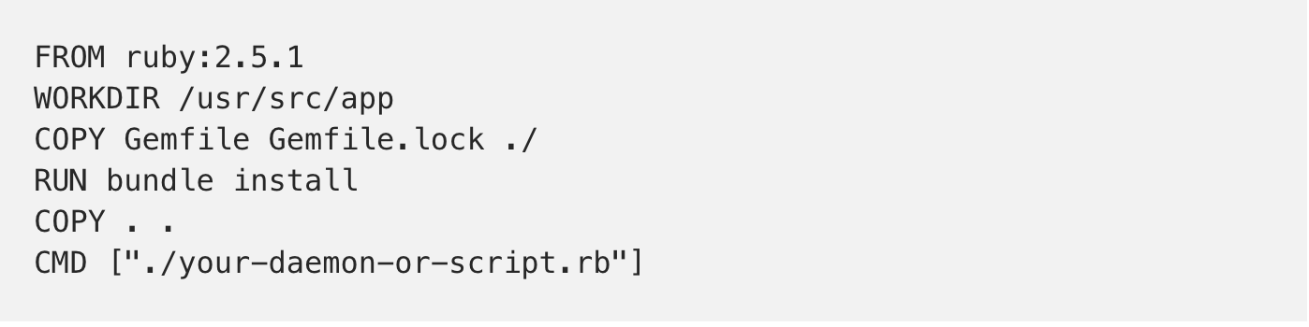
Dockerfile best practice
Devops.Course

Slide 5
Dockerfile best practices
Docker recommends using COPY to create image layers in a way that keeps different file contexts in separate image layers. This means rebuilding the image is efficient. The files least likely to be changed should be in lower layers, while the files most likely to change should be added last.
Devops.Events

Slide 6
Dockerfile best practices
Although ADD and COPY are functionally similar, generally speaking, COPY is preferred. That’s because it’s more transparent than ADD. COPY only supports the basic copying of local files into the container, while ADD has some features (like local-only tar extraction and remote URL support) that are not immediately obvious. Consequently, the best use for ADD is local tar file auto-extraction into the image, as in ADD rootfs.tar.xz /
Devops.Events

Slide 7
Dockerfile best practices
Because image size matters, using ADD to fetch packages from remote URLs is strongly discouraged; you should use curl or wget instead. That way you can delete the files you no longer need after they’ve been extracted and you don’t have to add another layer in your image.
Devops.Events

Slide 8
Dockerfile best practices
If <source> is a local tar archive in a recognized compression format, then it is automatically unpacked as a directory into the Docker image. For example: ADD rootfs.tar.xz /. This is the main recommended use of ADD over COPY in Dockerfiles.
Devops.Events

Slide 9
Containers
Devops.Course

Slide 10
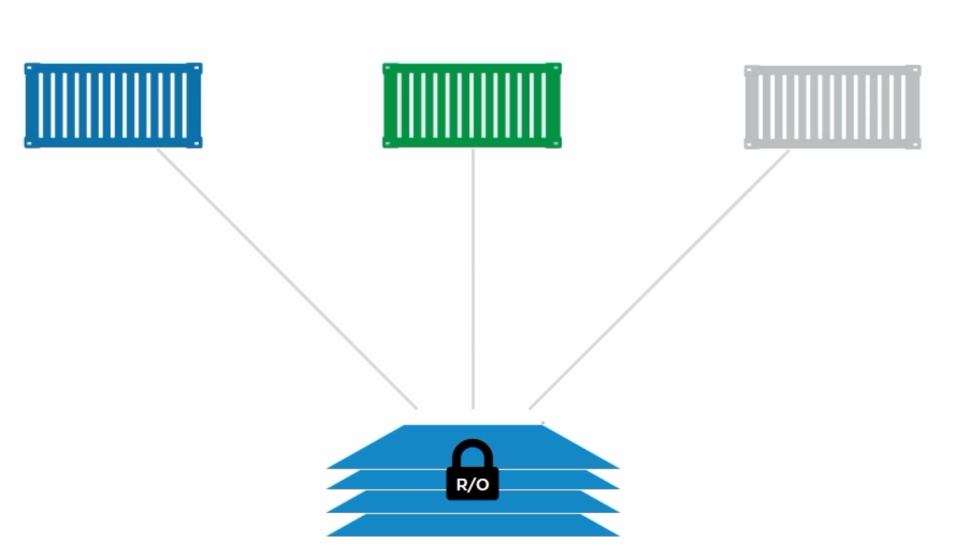
Pull Manifest
Pull Layers
Containers

Slide 11
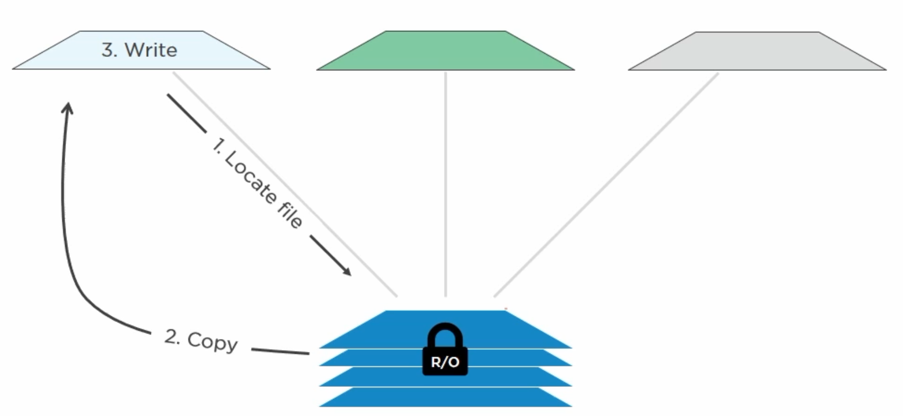
Pull Manifest
Pull Layers
Containers

Slide 12
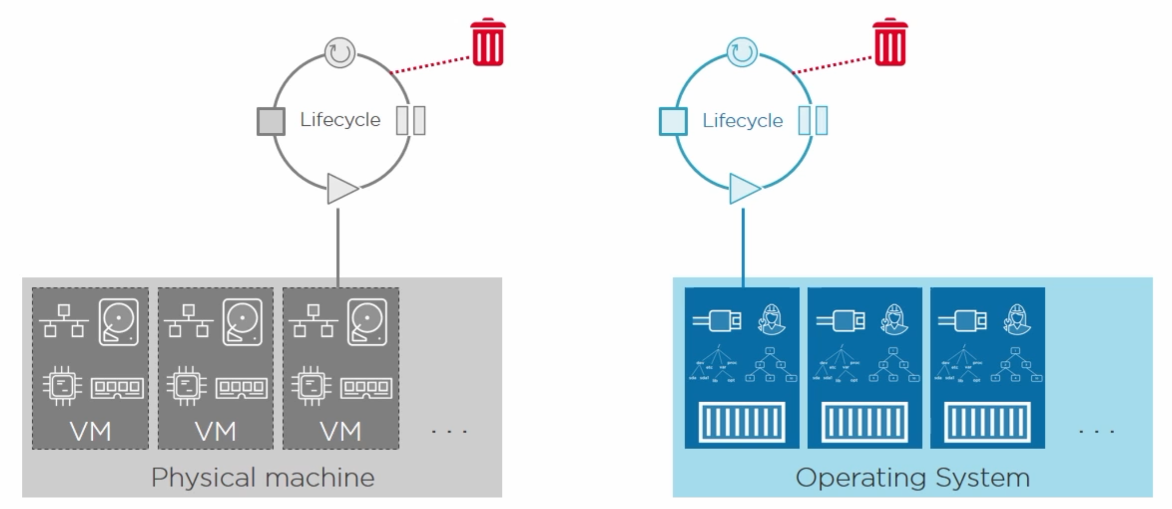
Pull Manifest
Pull Layers
Containers

Slide 13
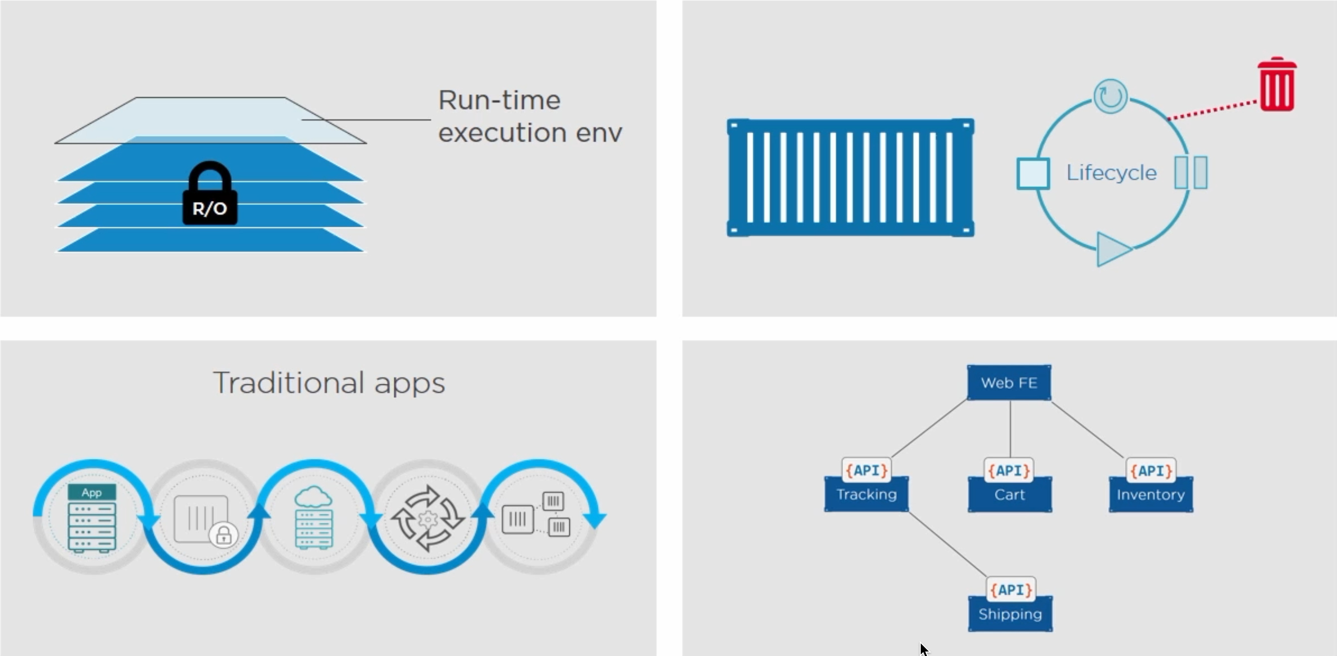
Pull Manifest
Pull Layers
Containers

Slide 14
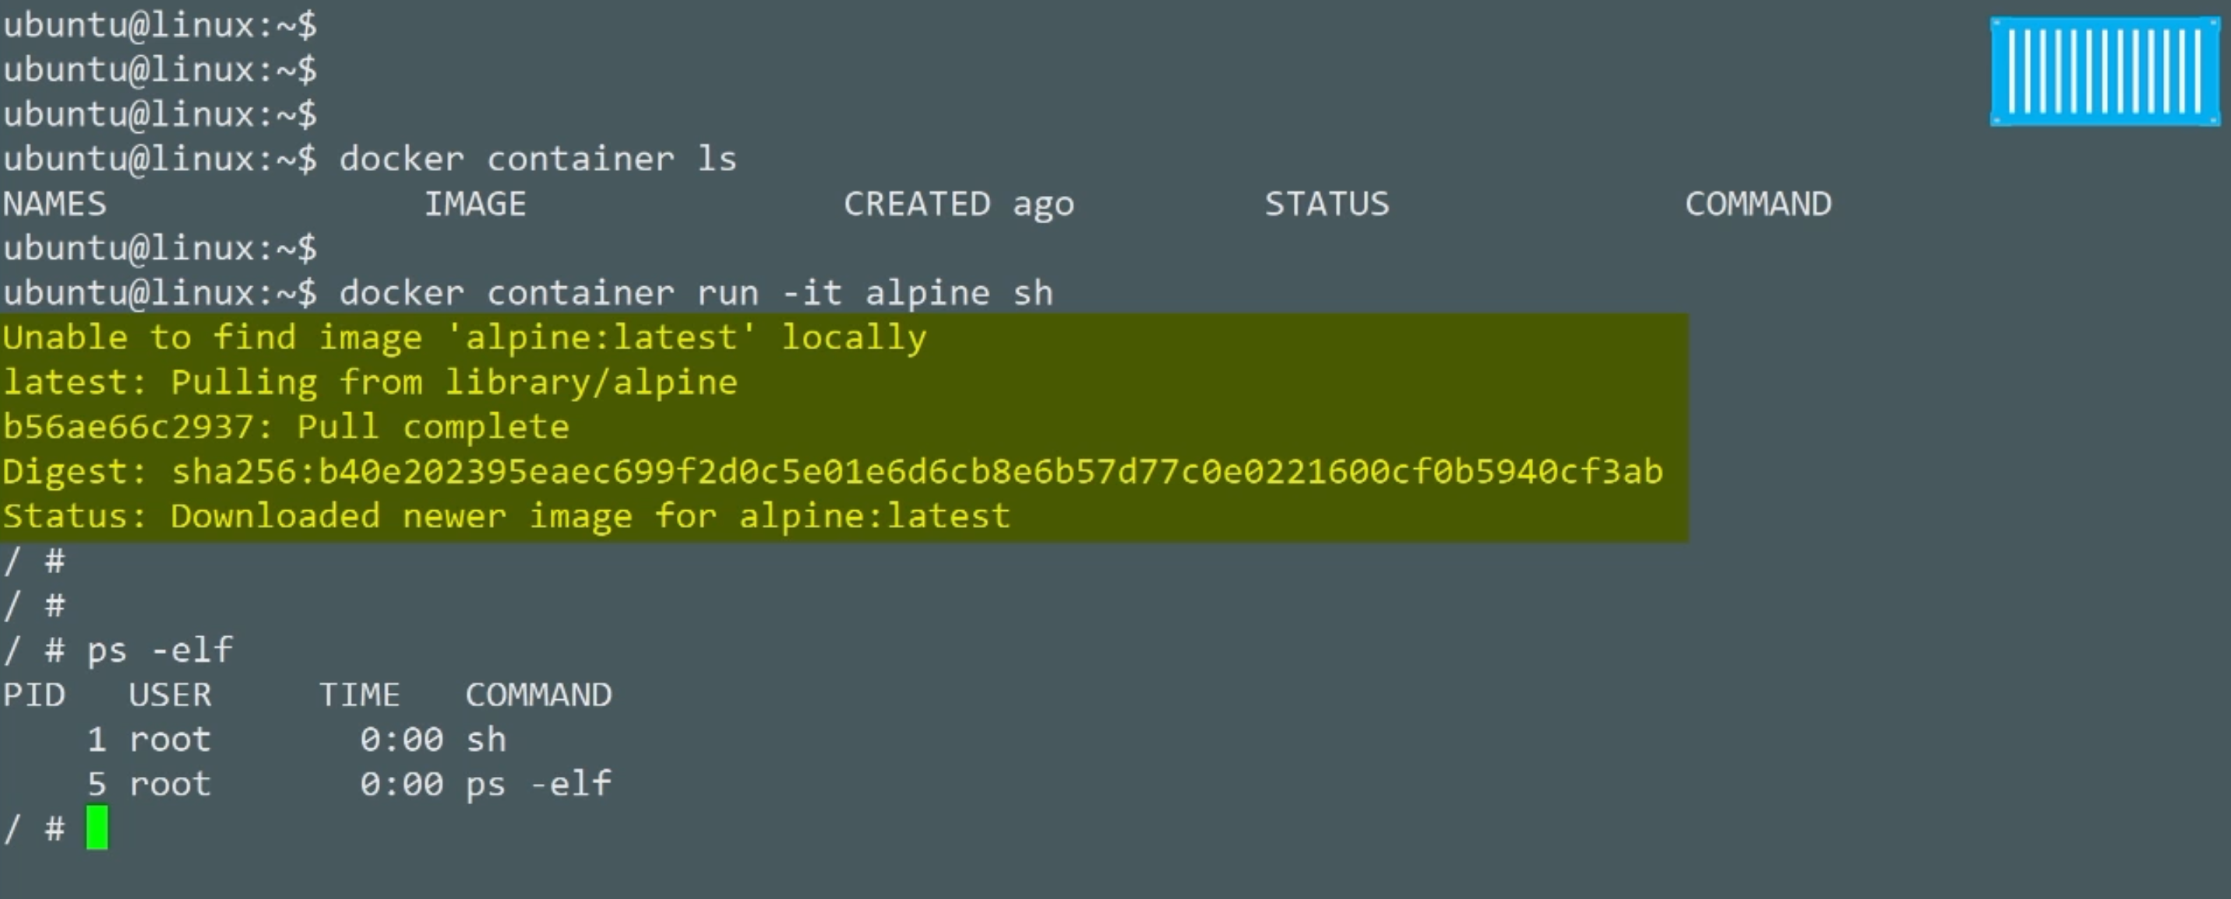
Pull Manifest
Pull Layers
Containers

Slide 15
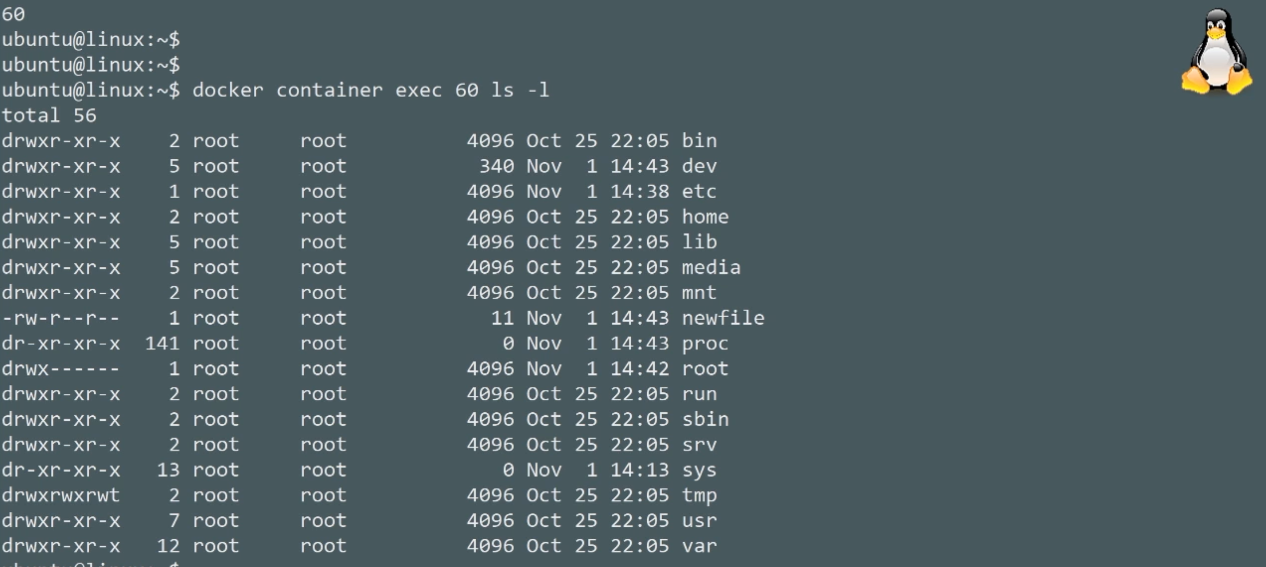
Pull Manifest
Pull Layers
Containers

Slide 16
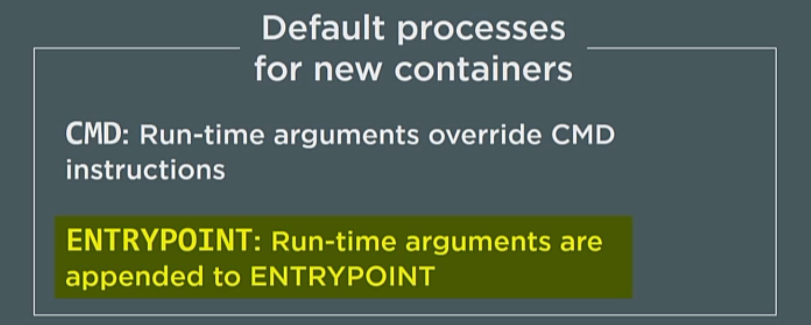
Pull Manifest
Pull Layers
Containers

Slide 17
Logging
Devops.Course

Slide 18
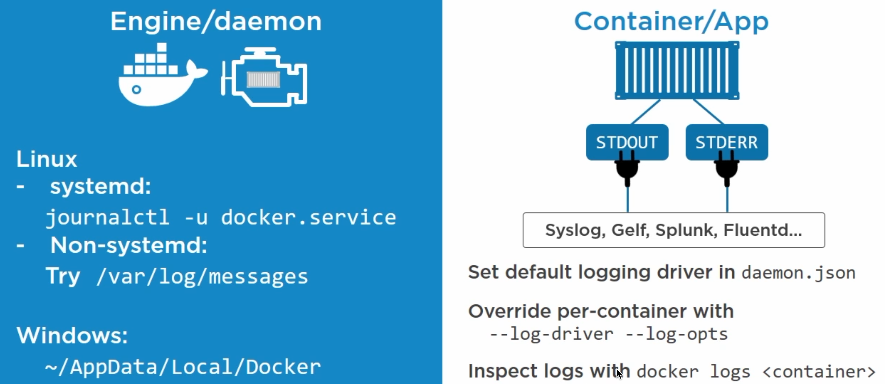
Pull Manifest
Pull Layers
Logging

Slide 19
Graceful shutdown
Devops.Course

Slide 20
docker stop
When you issue a docker stop command Docker will first ask nicely for the process to stop and if it doesn't comply within 10 seconds it will forcibly kill it. If you've ever issued a docker stop and had to wait 10 seconds for the command to return you've seen this in action
The docker stop command attempts to stop a running container first by sending a SIGTERM signal to the root process (PID 1) in the container. If the process hasn't exited within the timeout period a SIGKILL signal will be sent.
N-DEV-05503:.docker Nick$ docker stop e1 --time=30
Devops.Events

Slide 21
docker kill
By default, the docker kill command doesn't give the container process an opportunity to exit gracefully -- it simply issues a SIGKILL to terminate the container. However, it does accept a --signal flag which will let you send something other than a SIGKILL to the container process.
For example, if you wanted to send a SIGINT (the equivalent of a Ctrl-C on the terminal) to the container "foo" you could use the following:
N-DEV-05503:.docker Nick$ docker kill e1 --signal=SIGINT
Devops.Events

Slide 22
docker rm -f
The final option for stopping a running container is to use the --force or -f flag in conjunction with the docker rm command. Typically, docker rm is used to remove an already stopped container, but the use of the -f flag will cause it to first issue a SIGKILL.
N-DEV-05503:.docker Nick$ docker rm af --force
Devops.Events

Slide 23
Receiving signals
When you use docker stop or docker kill to signal a container, that signal is sent only to the container process running as PID 1.
N-DEV-05503:.docker Nick$ docker inspect -f '{{.State.ExitCode}}' 4dd
Devops.Events

Slide 24
Networking
Devops.Course

Slide 25

Bridge network
Bridge driver for LINUX / NAT driver for wiNDOWS
Devops.Events

Slide 26
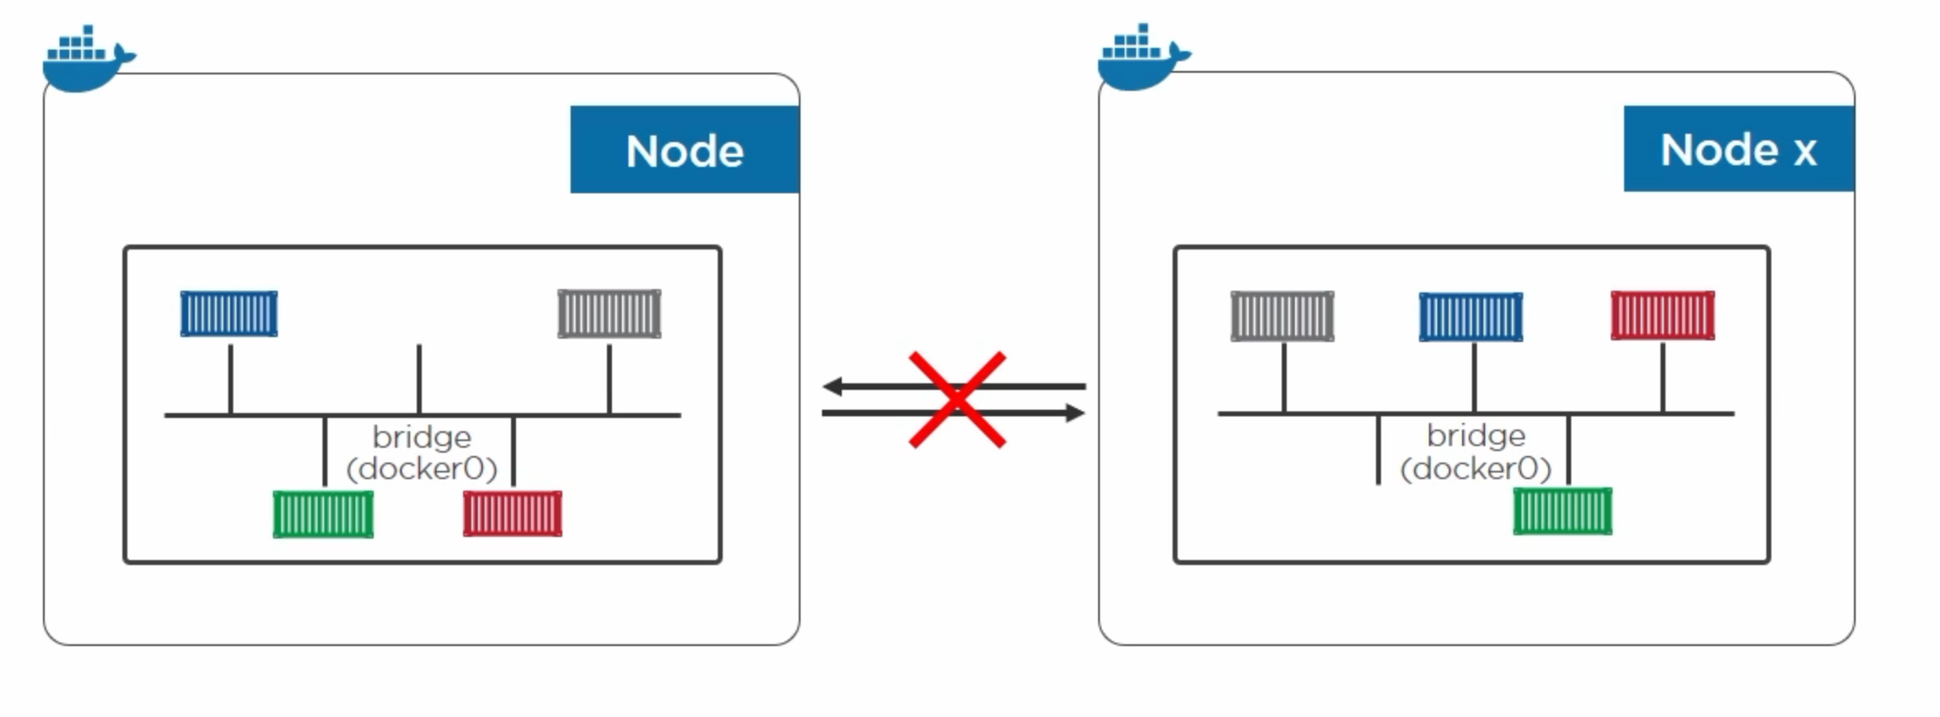
Bridge network
Devops.Events

Slide 27
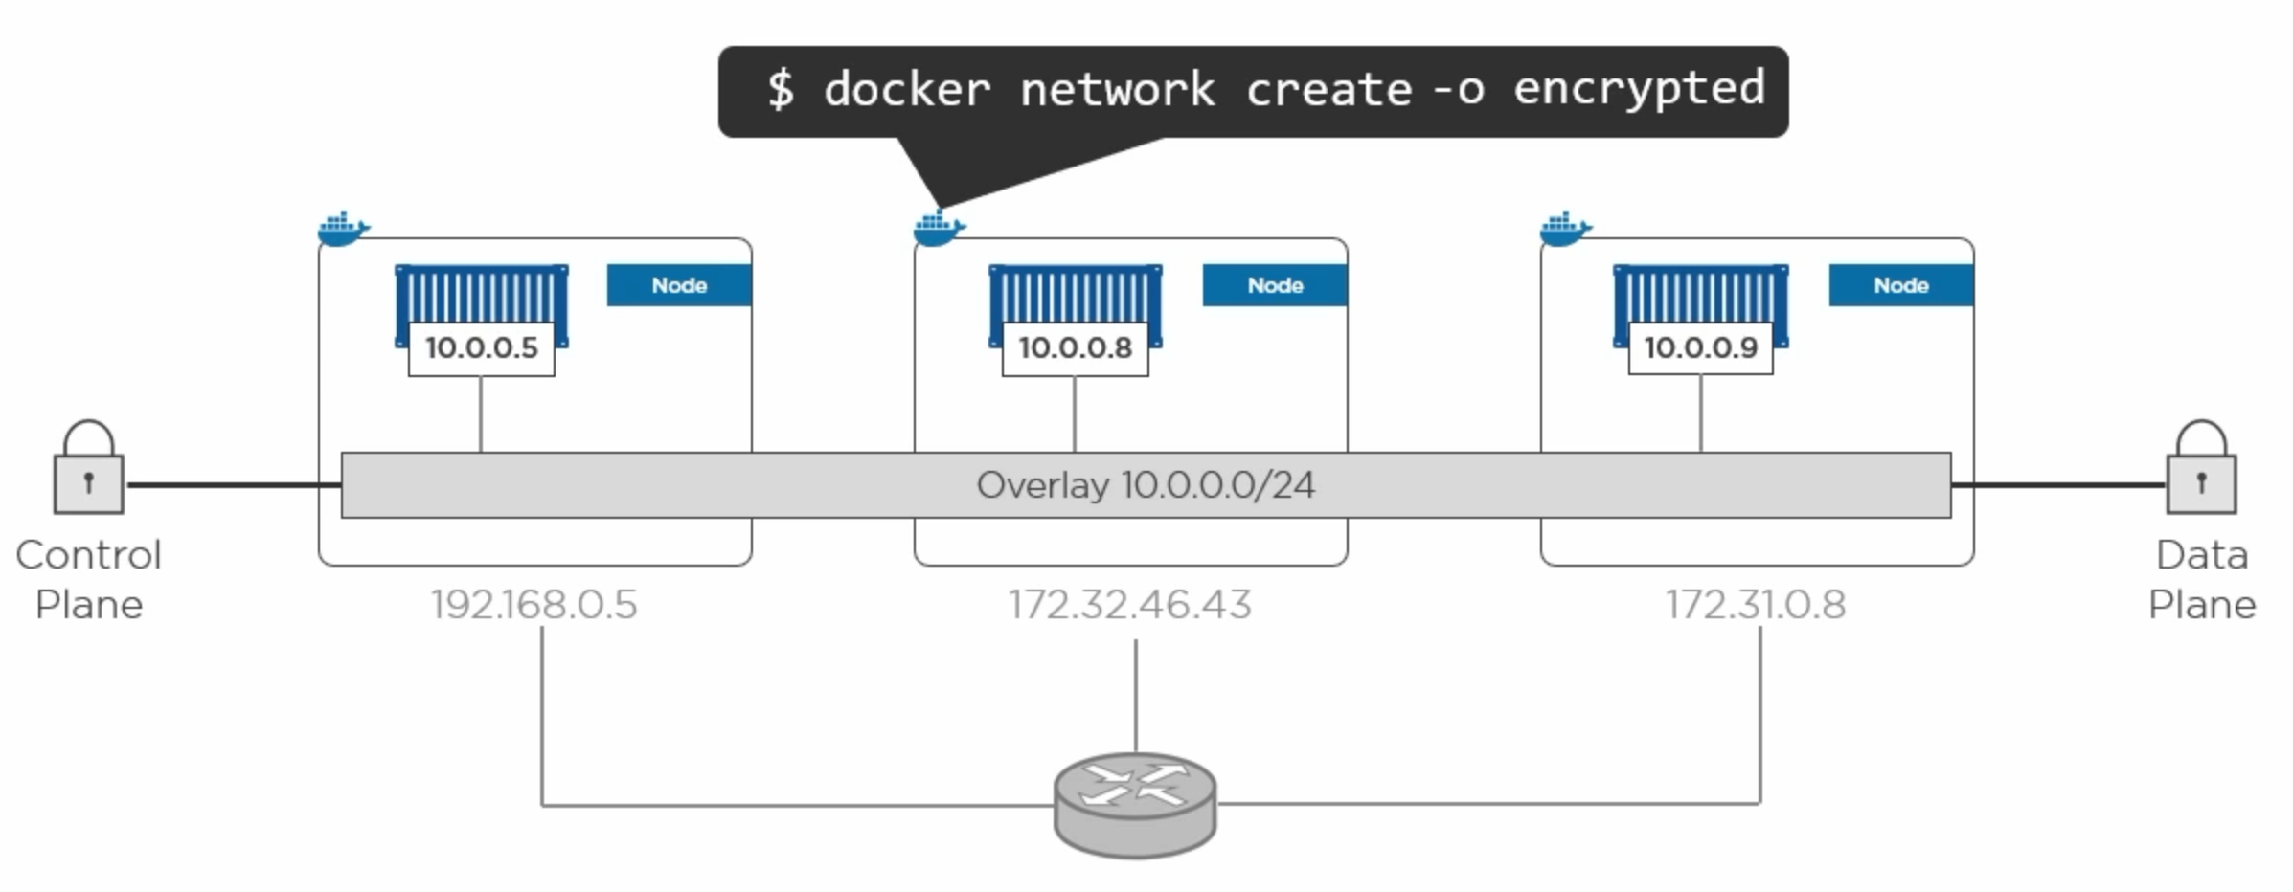
Overlay network
Devops.Events

Slide 28
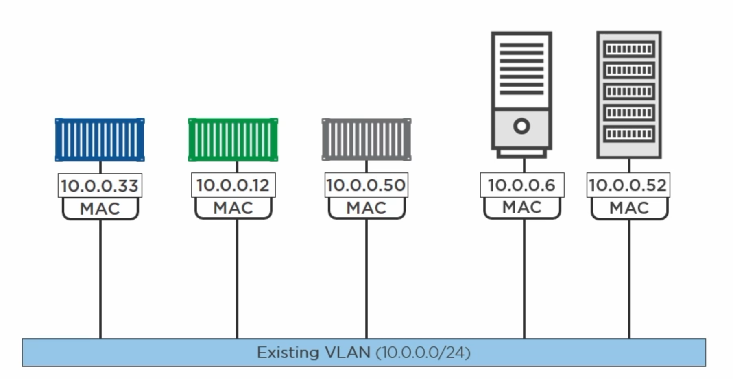
Macvlan
MUST allow promiscuous mode
Devops.Events

Slide 29
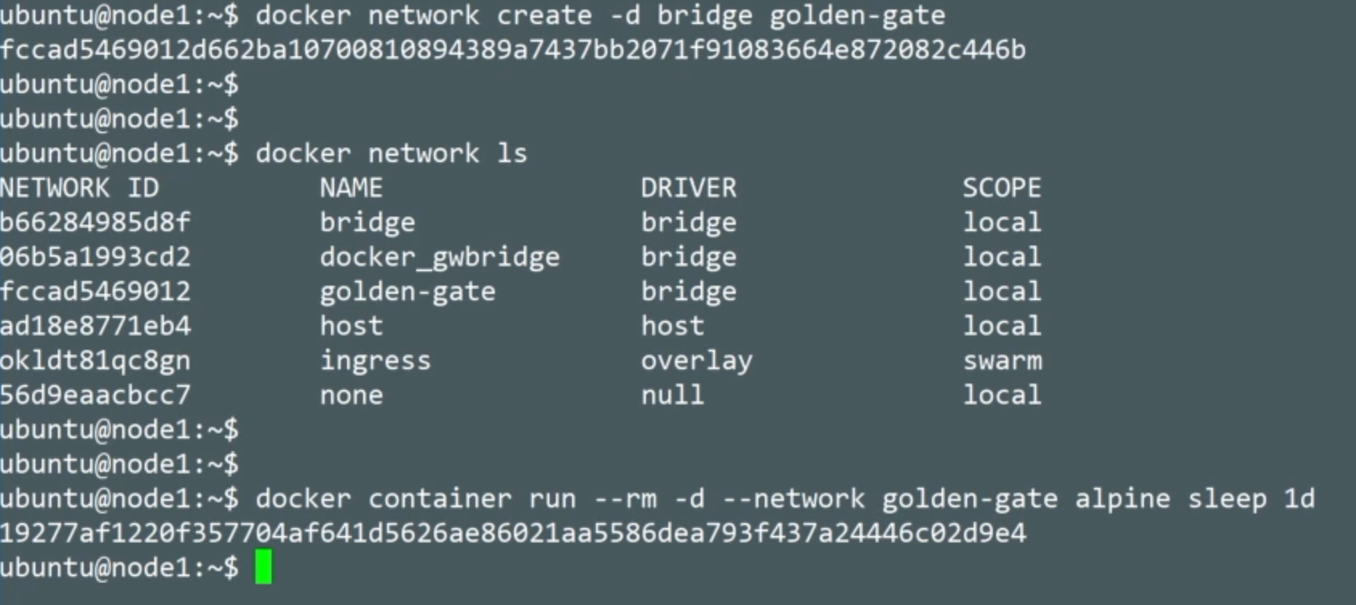
Main Commands
Devops.Course

Slide 30
Main Commands
Devops.Course

Slide 31
Main Docker Commands
docker pull <image_name>
docker images
docker ps -a
docker rm <id/container_name>
docker run --name <name> -dp <port#>:<port#> <image_name>
docker exec -it <name> <command>
Devops.Events

Slide 32
Main Docker Commands
docker stop <container_name>
docker rm <id/container_name>
docker rmi <image_name>
docker rm $(docker ps -q -f status=exited)
Devops.Events

Slide 33
docker-compose
Devops.Events

Slide 34
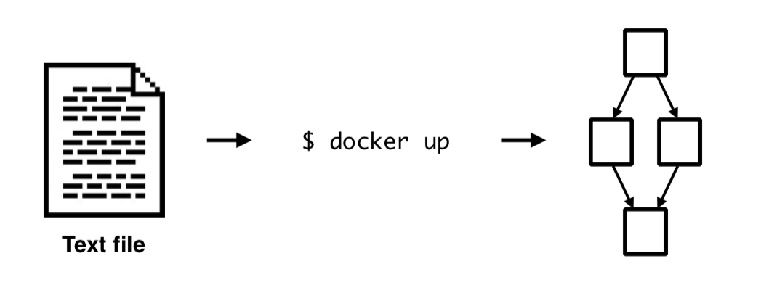
Docker Compose
Devops.Events

Slide 35
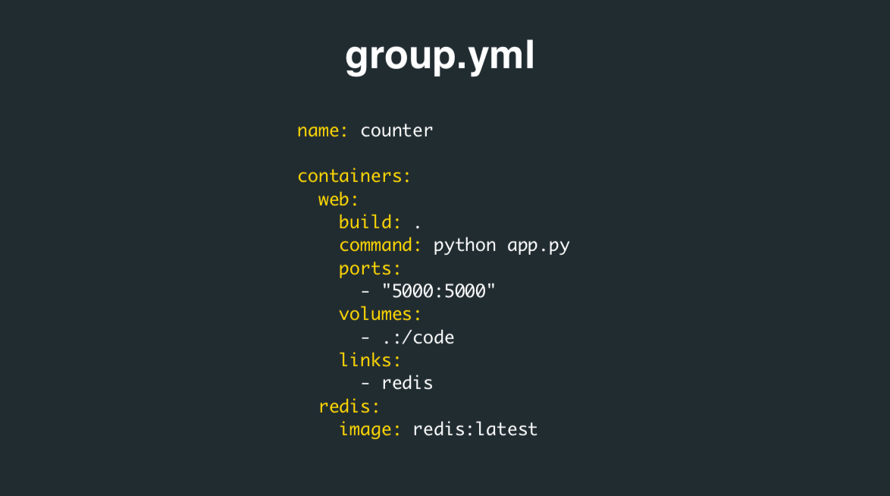
Docker Compose
Devops.Events

Slide 36
Main Docker Commands
docker-compose up -d —no-deps
docker-compose down -t <time_in_sec>
docker-compose rm
exec <name> COMMAND [ARGS...]
docker-compose rm <id/container_name>
docker-compose restart -t <time_in_sec>
Devops.Events

Slide 37

Questions ?
Devops.Course

Slide 38
Thanks for attentions!
Devops.Course

